Slide 1
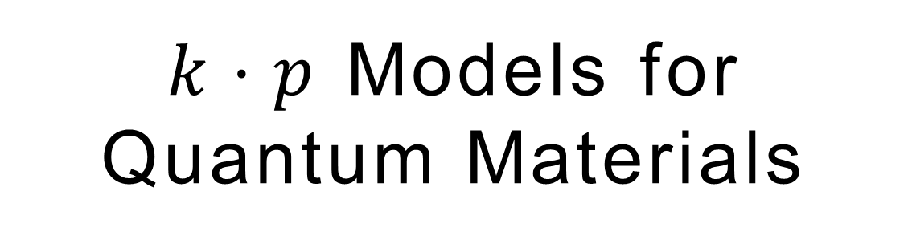
$k⋅p$ Models for
Quantum Materials

Slide 2
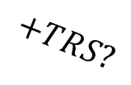

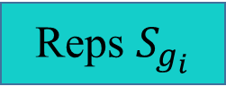

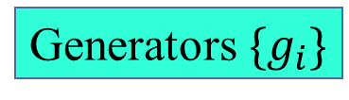
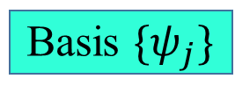
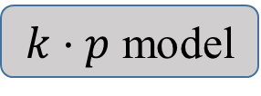
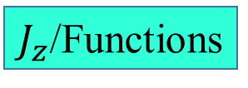

Overview
Semiconductors with ab-initio calculations
$$G_{\vec{k}}$$
$$Γ_{i}$$
Bands
Generators $\{g_{i}\}$
$J_{z}$/Functions
Basis $\{ψ_{j}\}$
$$+TRS?$$
Complete?
Reps $S_{g_{i}}$
fit
$$S_{g_{i}}H\left(\vec{k}\right)S_{g_{i}}^{−1}=H\left(g_{i}\vec{k}\right)$$
2003, Winkler(book)
2009, Lok C. Lew, et. al.
CX Liu, PRB 82, 045122
……
$k⋅p$ model

Slide 3
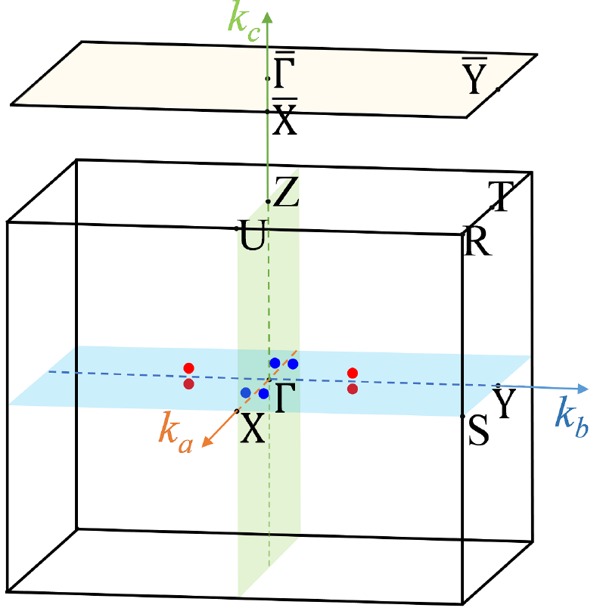
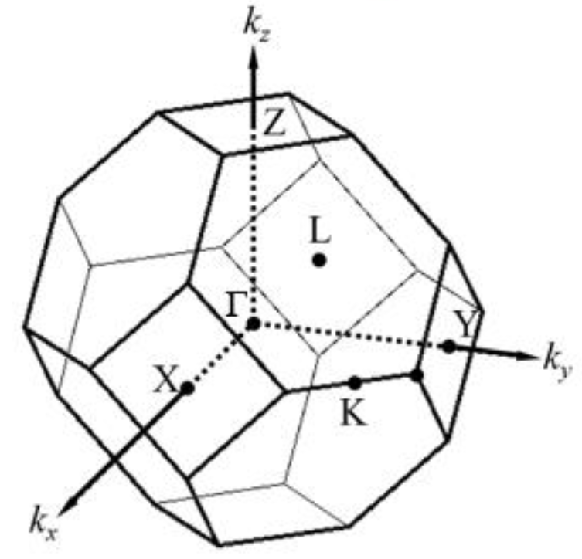
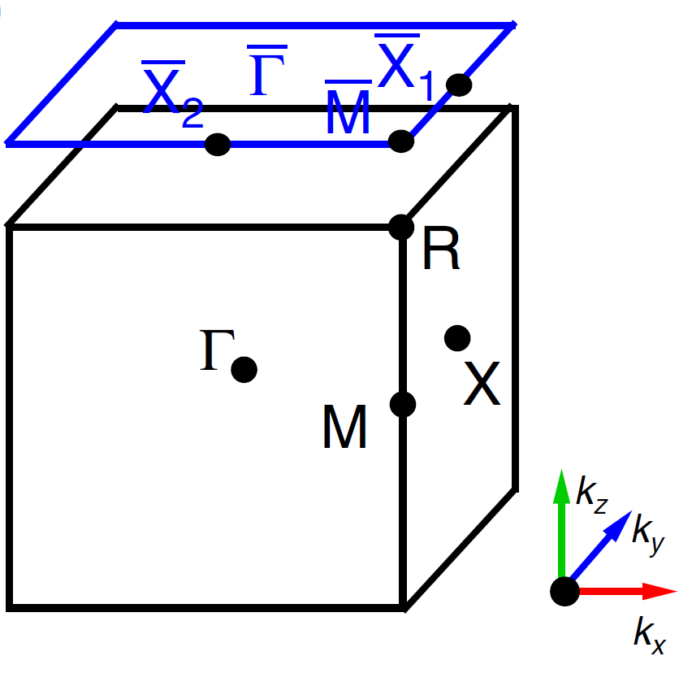
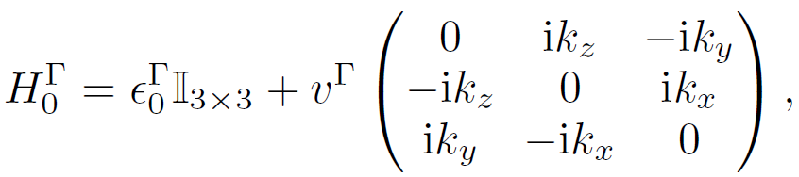
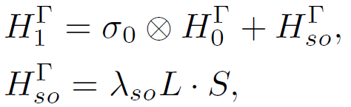

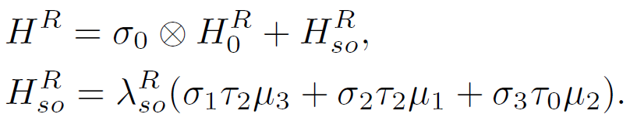
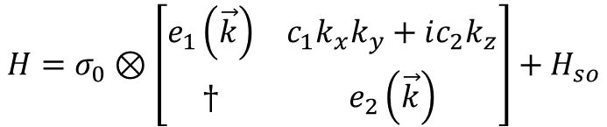

Point/Space Groups + Atomic Orbitals
${Ag}_{2}S$ (19$P2_{1}2_{1}2_{1}+sp$): Charge-2/Weyl
*ZW Wang, *KF Luo, JZ Zhao, R Yu, arXiv: 1810.09231
$$H=σ_{0}⊗\left[\begin{matrix}e_{1}\left(\vec{k}\right) & c_{1}k_{x}k_{y}+ic_{2}k_{z} \\ † & e_{2}\left(\vec{k}\right)\end{matrix}\right]+H_{so}$$
${Nb}_{2}{Tl}_{2}O_{7}$ (217$Fd\overline{3}m+t_{2g}$): Spin-1 Weyl/Dirac/TI
W Zhang, KF Luo, R Yu, C Fang, HM Weng, arXiv: 1903.00891
$$H_{1}\left(k_{z}\right)=\left[e(k_{z})σ_{0}+c\left(k_{z}\right)σ_{1}\right]⊕Λ_{2×2}$$
$$H_{2}\left(k_{z}\right)=σ_{0}⊗\left(H_{DKK}+H_{Strain}\right)+L⋅S$$
$PdBiSe$ (198$P2_{1}3+s$): Weyl/R-S-Weyl/Spin-1/Charge-2
BQ Lv, ZL Feng, ZJ Zhao, N Yuan, A Zong, KF Luo, et. al., PRB 99, 241104(R)

